Slide 1
Entrepreneurship BS-CS – 2022 – Spring Semester
Salmaan Rahman
Lecture 7
Financial Strength and Viability

Slide 2
Financial Viability
The ability to pursue an opportunity and turn that opportunity into a viable entrepreneurial business hinges on the availability of money.
Regardless of the quality of a product or service, a company can’t be viable in the long run unless it is successful financially.
Money comes from:
Self-funding (equity)
External sources (investors or lenders)
Internally generated (earnings)

Slide 3
Financial flows
Money is spent on financial obligations
Financial obligations need to be balanced either with funding, or earnings
Earnings are rarely immediately accessible
Net30, net60, - accounts receivable
Costs of production need to be covered prior to earnings
Parts, salaries, routine bills, shipping, marketing etc.
For a start up firm, initial earnings often go towards covering immediate bills and establishing growth, rather than profits.

Slide 4
Financial management questions
How are you doing? Are you making or losing money?
How much cash do you have on hand?
Do you have enough cash to meet short-term obligations?
How efficiently are you utilizing assets?
How does your growth and net profits compare to those of industry peers?
Where will the funds needed for capital improvements come from?
Are there ways you can partner with other firms to share risk and reduce the amount of cash needed?
Overall, are you in good shape financially?

Slide 5
Business Financial Objectives
Profitability – ability to earn beyond covering costs
Most new ventures are not profitable for 1-3 years
Liquidity – Ability to meet short-term obligations (cash on hand)
Liquidity is influenced by
Accounts receivable – cash to be received
Inventory - raw materials and prepared goods to be sold
Efficiency – assets vs. revenue and profits
Stability – for a firm to be ‘stable’, it must earn a profit, remain liquid, and have minimal debts
Measured using the debt-to-equity ratio: debt/equity

Slide 6
Financial Statement
Historical Financial Statements: a written report that quantitatively describes a firm’s financial standing
income statement – how much money firm is making
balance sheet
statement of cash flows
Forecasts - estimate of a firm’s future income and expenses
based on its past performance, current circumstances, and future plans.
New ventures base forecasts on feasibility study results
estimate of sales and then on
industry averages or the
experiences of similar start-ups
Budgets - itemized forecasts of a company’s income, expenses, and capital needs

Slide 7
Historical Financial Statements Income Statement
An income statement reflects the results of the operations over a specified period of time
Monthly, Quarterly, Yearly
Net Sales: total sales minus returned goods, discounts
Cost of Sales: Direct costs of production, delivery
Material costs + labor
Operating expenses:
Marketing, administrative, other

Slide 8
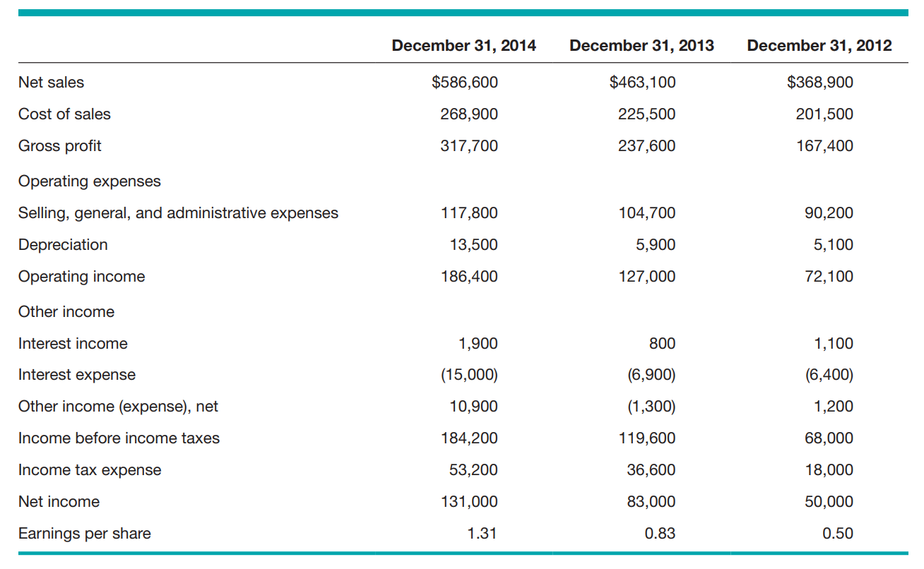

Slide 9
Historical Financial Statements Balance Sheet
Balance sheet - a snapshot of a company’s assets, liabilities, and owners’ equity
Covers only a specific point in time
Major categories:
Current assets: cash plus items readily convertible to cash (accounts receivable, marketable securities, inventories)
Fixed assets: assets used over long time frame (real estate, equipment, furniture)
Other assets: Miscellaneous assets, (accumulated goodwill, brand name
Current liabilities: Obligations payable within a year (accounts payable, accrued expenses, current portion of long-term debt)
Long-term liabilities: Notes or loans repayable beyond one year, including liabilities associated with purchasing real estate, buildings, and equipment.
Owners’ equity: equity invested in business by its owners plus accumulated earnings retained by the business after paying dividends.

Slide 10
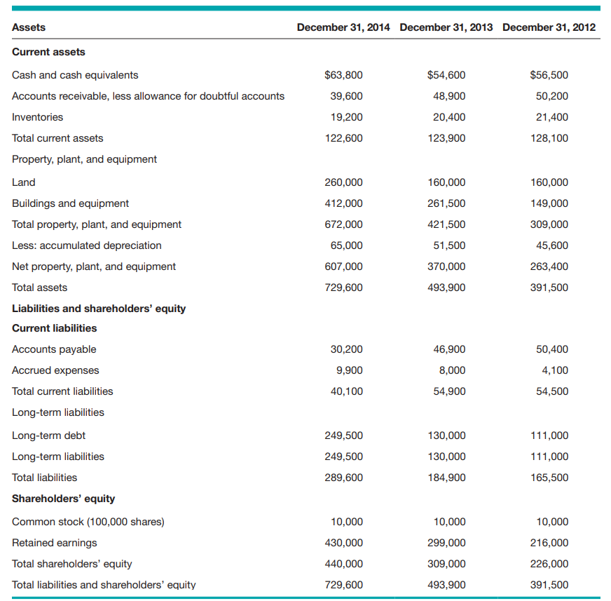

Slide 11
Historical Financial Statements Statement of Cash Flows
Statement of Cash Flows: summarizes changes in a firm’s cash position for a specified period of time and provides details why the change occurred.
A firm’s net income, taken from its income statement, is the first line on the corresponding period’s cash flow statement
Similar to a month-end bank statement.
how much cash is on hand at the end of the month
how the cash was acquired
How it was spent during the month.
Divided into three separate activities:
Operating activities: net income (or loss), depreciation, changes in current assets and current liabilities
Investing activities: purchase, sale, or investment in fixed assets (real estate, equipment, buildings)
Financing activities: cash raised (borrowing money or selling stock and/or cash used during the period by paying dividends, buying back outstanding stock, or buying back outstanding bonds)

Slide 12
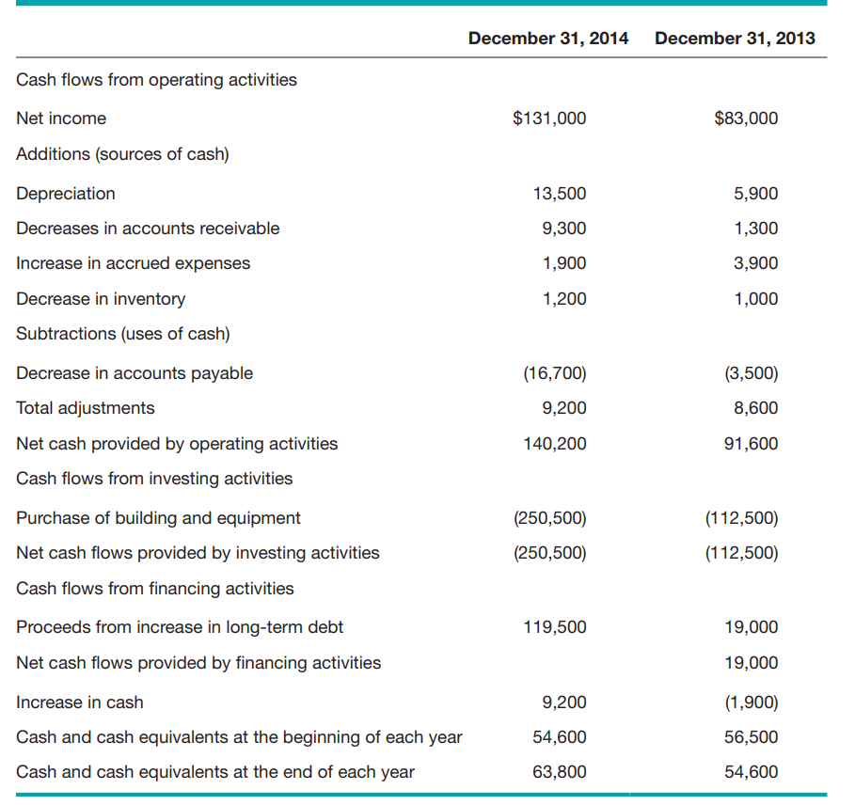

Slide 13
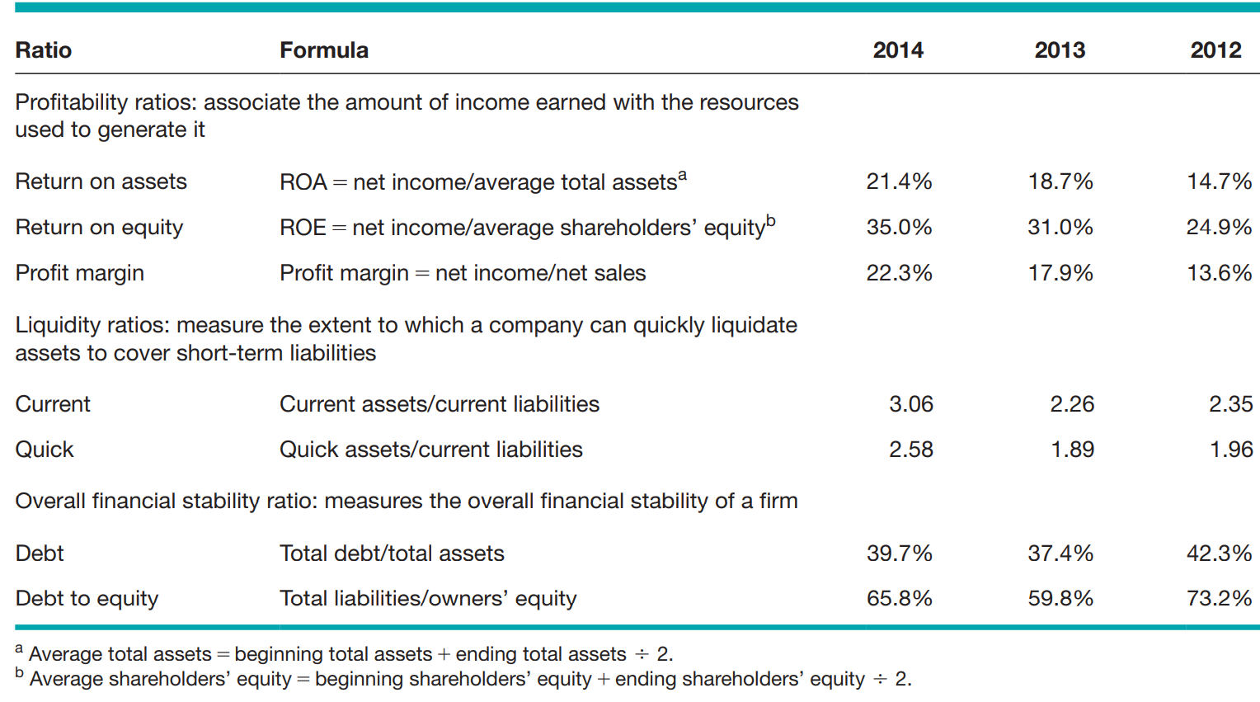
Historical Financial Statements Ratios

